Slide 1
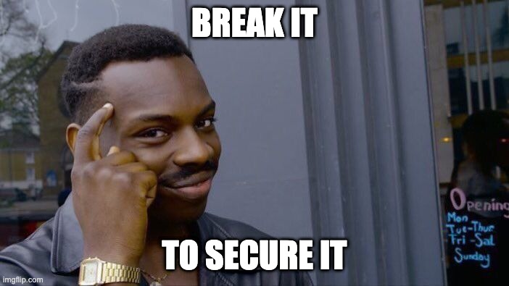
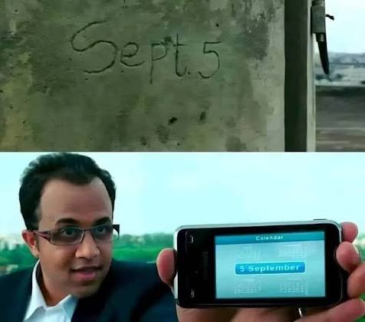
.NET HUB KATHMANDU · GITHUB COPILOT DEV DAYS
Think Like an Attacker. Build Like a Defender.
INSECURE SECURE
Notes:
Opening. Don't rush this slide — let the two panels sit there for a few seconds. Say something like: "On the left is what most of us do all day. We get a requirement, we write an endpoint, it returns the right thing, the tests pass, we ship. On the right is the exact same application — same code, same server — being asked a slightly different question. Nobody broke encryption. Nobody dropped a zero-day. Somebody just changed a number." Key lesson: the attacker isn't looking at a different application. They're looking at the same application with a different intent. Set expectations: "This is not an OWASP training. I'm not going to read you a top ten list. I want to show you how a small, reasonable-looking .NET mistake turns into an incident, and how attackers actually decide what to attack." Transition: "But first, thirty seconds about why I care about this."

Slide 2

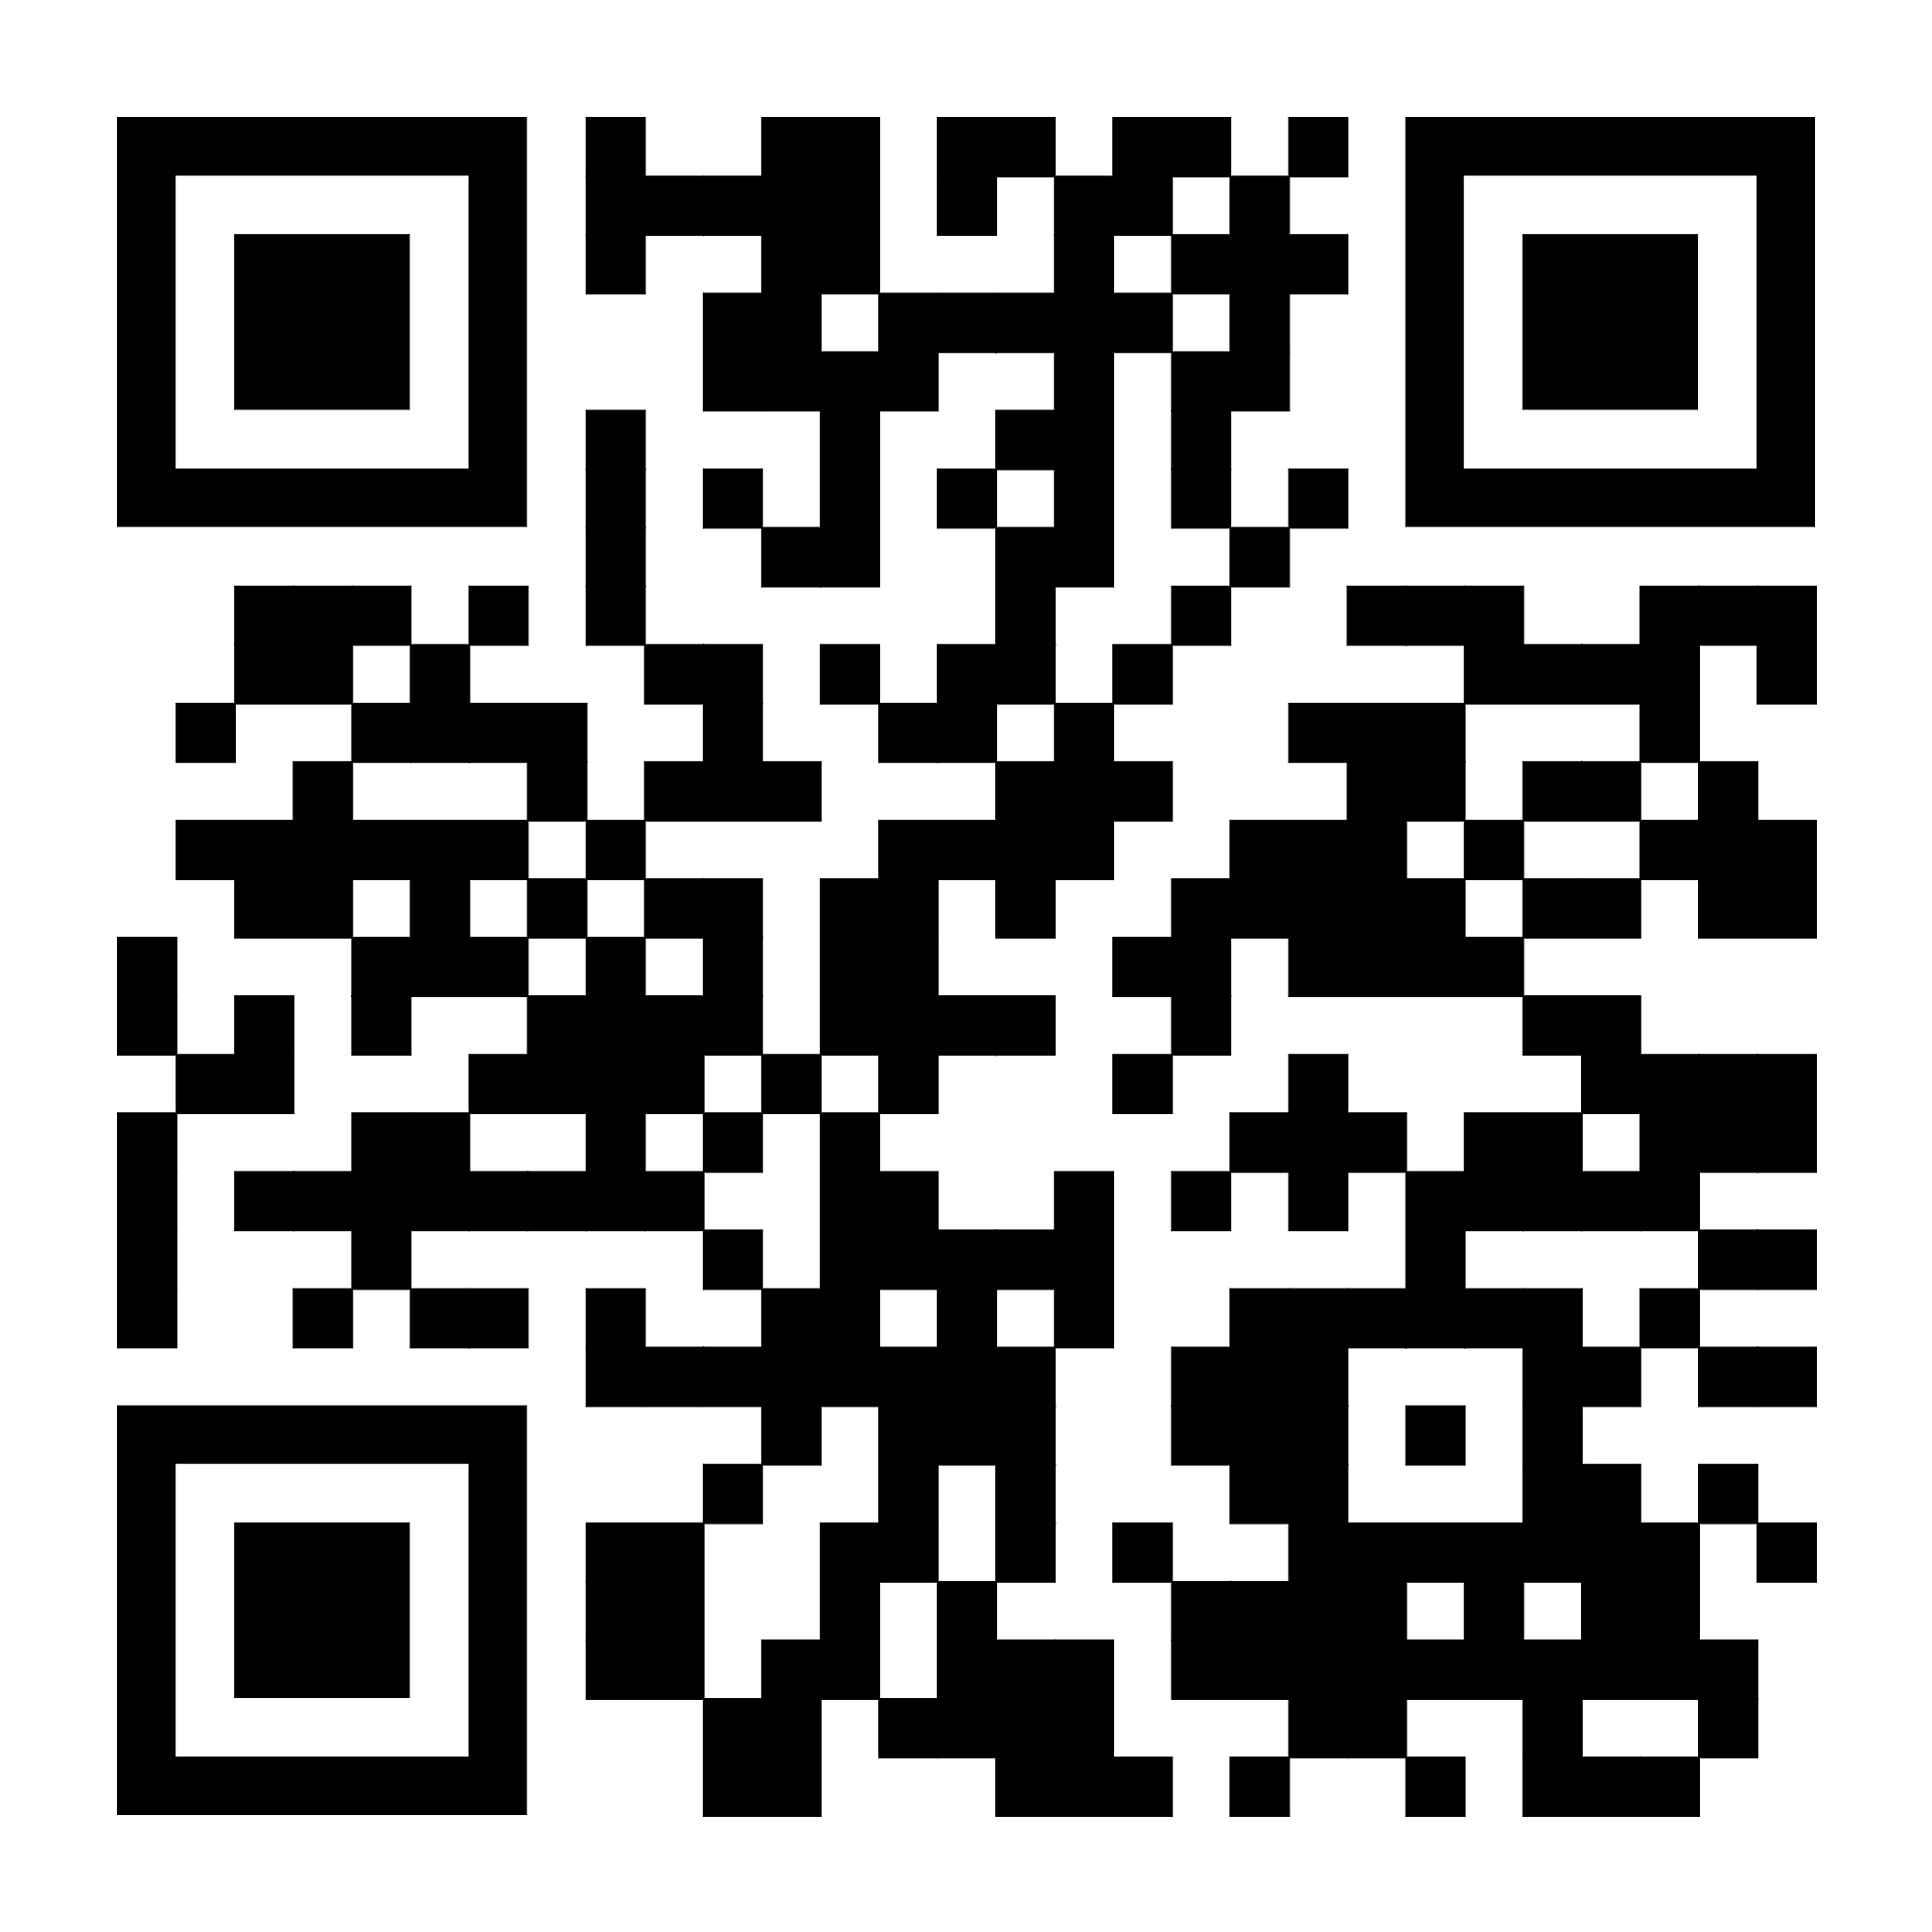


$whoami
Before We Talk About Hacking...
What I do?
IS Audit, VAPT, Security Hardening, Digital Forensics, Security Architecture, Threat Hunting
Background
7+ years experience in cybersecurity | M.Sc. Cybersecurity | CySA+ | ISO 27001 LA
Bipul Ghimire
Senior Security Engineer | Security Consultant | Ethical Hacker | Seasonal Bug Bounty Hunter | Guest Lecturer | Educator/Mentor
Why this matters to me
Security is a shared responsibility, and everyone should be aware on how to stay safe.
Notes:
Keep this SHORT. Ninety seconds, maximum. Nobody came for your CV. Fill in the placeholders on the right with your real details — name, role, certifications, skills. Do not invent anything; if you don't have certifications, delete that line. An honest "I've been writing C# for six years and I got curious about breaking things" is more credible than a wall of acronyms. The story that actually matters is the ladder on the left: I was a developer, I got curious about how things break, that curiosity turned into security work, and now I spend my time helping developers avoid the mistakes I used to make myself. Key lesson to plant: attackers are not a different species. Most of them started exactly where you are — they just kept asking "what happens if...?" Audience interaction: "Quick show of hands — who here has ever deliberately tried to break their own feature?" Note who raises a hand; call back to them later. Transition: "So let me ask you all a question."

Slide 3
What if the attacker
knows your application
better than you do?
THE DEVELOPER ASKS
THE ATTACKER ASKS
"Does the feature work?"
"How do I make it work
somewhere it was never
supposed to?"
Notes:
Deliver the big question, then STOP TALKING. Count to three in your head. Silence does the work here. Then: "I mean it seriously. An attacker will spend an entire weekend on one endpoint of your application. They will read every response header, every error message, every JSON field you forgot to remove. When was the last time you spent a whole weekend on a single one of your own endpoints?" The two boxes are the heart of the entire talk. Developers optimise for the happy path — that's not a criticism, that's the job. Attackers spend all of their time in the unhappy path, which is exactly the part we test least. Real-world analogy: a hotel builds a door for guests. A burglar looks at the same building and sees a fire escape, a delivery entrance, a window left open on floor two, and a cleaner who props the back door with a brick. Same building. Different map. Transition: "Let's put those two mindsets side by side properly."

Slide 4
TWO PEOPLE, ONE APPLICATION
Same Code. Opposite Questions.
DEVELOPER
ATTACKER
How do I implement this?
What if I shouldn't have access?
Does it work?
What if I change this ID?
What if I remove this parameter?
Is it fast enough?
What if I call the API directly?
Can users access it?
What if I automate this 10,000 times?
Can we ship it today?
What if I chain two small weaknesses?
"Attackers don't see features. They see attack surface."
Notes:
Walk the left column fast — the audience lives there, they'll nod along. Slow down on the right. Read those six questions out loud, one at a time, with a beat between them. The last one is the important one: "What if I chain two small weaknesses?" Flag it now, because the whole middle of this talk is about chaining. Key lesson: neither list is wrong. The developer list is literally the job description. The problem is that most teams only ever run the left column, and then production runs the right column for them, in public. Audience interaction: "Look at the right-hand column. Be honest — how many of those questions get asked in your average code review?" Usually the honest answer is one, sometimes zero. Analogy: your QA team tests that the lock opens with the key. An attacker tests whether the door opens without one, whether the frame is loose, and whether the window next to it is even locked. Transition: "So if attackers see attack surface, let's actually look at the attack surface of a normal ASP.NET Core application."

Slide 5
$pwd
Where .NET Applications
Break
Not exotic bugs. The ordinary ones we ship every sprint.
Notes:
Short breath slide. Use it to reset the room. "Act one: your application works. Everything I'm about to show you is code that passes review, passes tests, and behaves perfectly for every honest user. That's exactly why these bugs survive to production." Transition straight into the architecture slide.

Slide 6
THE MAP
Every Layer Is a Trust Decision
Browser / Client
Configuration
Authentication
CDN / WAF
ASP.NET Core Host
Secrets
Authorization
Middleware Pipeline
NuGet dependencies
Input validation
Authentication
Authorization
Cloud identity
File uploads
Controllers / Minimal APIs
Business Logic
Logging & alerting
Serialization
EF Core
Database
CI/CD pipeline
External APIs / Cloud / Storage
"Every boundary is a question — and somebody already answered it for you."
Notes:
Don't read the stack out loud — everyone here knows it. Point at it and reframe it. "This is not an architecture diagram. This is a list of places where one component decides to trust another one. Middleware trusts the host. The controller trusts that authentication middleware did its job. Business logic trusts the controller. EF Core trusts whatever string you handed it. The database trusts EF Core completely." Note the three highlighted layers — authentication, authorization, controllers. That's where we'll spend most of the next twenty minutes, because that's where the money is. Key lesson: security bugs almost never live inside a layer. They live in the gap between two layers, where each one assumed the other one was handling it. Audience interaction: "Point at one of these chips and ask yourself — for the app you're on call for, who owns that box? If nobody in your head answered, that's your homework." Transition: "So which of these actually go wrong in real .NET applications? Let's look at the greatest hits."

Slide 7
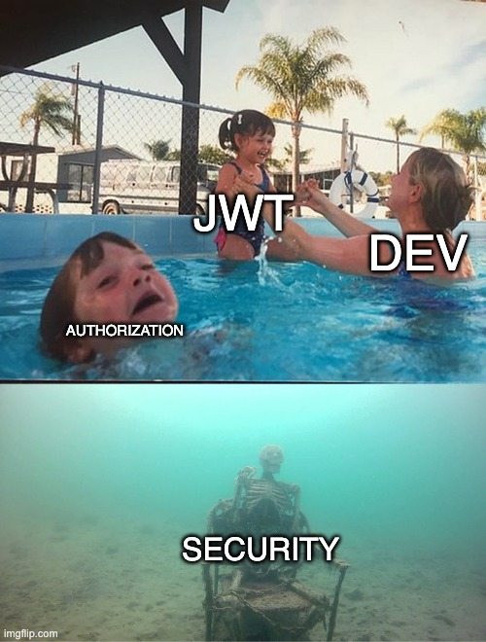
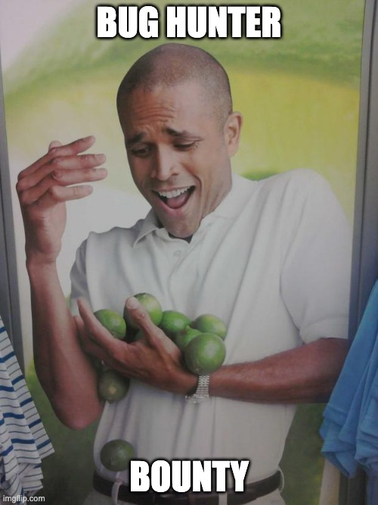
We have implemented JWT. Meanwhile,...
Authentication ≠ Authorization
Notes:
BEFORE YOU PRESENT: replace this placeholder with a genuine, existing meme image — do not generate one with AI, and do not invent a source URL. Search knowyourmeme.com or imgflip.com for "it works on my machine", pick an image you're comfortable using, drop it into the dashed frame, and type the real source into the attribution line. Delivery: this is a breather after a heavy technical stretch. Show it, let the room laugh for a few seconds, then land the point in one sentence and move on. Don't explain the joke. The line that connects it back: "Every one of us has said this. The attacker doesn't attack your machine. They attack the one with the public IP and the config you never re-read." Transition: "Speaking of things we never re-read — let's talk about your appsettings file."

Slide 8
THE MISTAKE BOARD
The Bugs We Actually Ship
Mapped to OWASP Top 10:2025 — because the categories changed, and two of them are new.
A01
A01
A01
A02
Broken access control / IDOR
SSRF (now folded into A01)
Missing object-level authz
Security misconfiguration
A02 / A04
A03
A05
A05
Secrets in config or Git
Vulnerable NuGet packages
SQL injection via raw SQL
XSS in Razor / SPA output
A05 / A06
A07
A08
A09
Insecure file upload
Weak auth & session handling
Unsafe deserialization
No logging, no alerting
A10:2025 — Mishandling of Exceptional Conditions is brand new: failing open, swallowed exceptions, verbose errors. We'll hit it later.
Notes:
Do NOT read twelve cards out loud. Sweep your hand across the board and pick three to talk about. Worth calling out explicitly, because it's news to a lot of developers: the OWASP Top 10 was updated for 2025. Broken Access Control is still number one. Security Misconfiguration jumped from five to two. Software Supply Chain Failures is a brand new category at number three — that's your NuGet folder. And SSRF is no longer its own category; it got folded into Broken Access Control, which honestly makes sense: SSRF is your server being tricked into making a request it wasn't allowed to make. Also new at number ten: Mishandling of Exceptional Conditions. Bad error handling, logic that fails open, exceptions you swallowed with an empty catch block. That one is going to sting a few people in this room. Key lesson: notice how many of the red cards are the same root cause. Access control isn't one bug. It's a category we keep re-implementing by hand, one endpoint at a time. Transition: "Let's talk about the single most misunderstood pair of words in our industry."

Slide 9
THE NUMBER ONE QUESTION
Authentication ≠ Authorization
AUTHENTICATION
AUTHORIZATION
"Who are you?"
"What are you allowed to do?"
GET /api/orders/123
Authorization: Bearer eyJhbGci...
→ user 42 is authenticated ✓
The question nobody asked:
"Can user 42 read order 123?"
THE DANGEROUS ASSUMPTION
WHAT AUTHORIZED ACTUALLY MEANS
[ Authenticated ] → [ Authorized ]
[ Authenticated ] + [ Object-level check ]
+ [ Business rules ] = [ Authorized ]
Notes:
This is the slide people photograph. Give it time. "Authentication is the bouncer checking your ID at the door. Authorization is whether you're allowed in the VIP room, behind the bar, or in the manager's office. We are extremely good at the bouncer. We are shockingly casual about the rest of the building." Walk the middle: a valid token proves user 42 exists and logged in. It says absolutely nothing about order 123. The token is an identity claim, not a permission slip for that specific row in that specific table. Key lesson — say it slowly: [Authorize] on a controller answers "is this person logged in and maybe in the right role". It does not answer "does this person own this record". Those are different questions, and only one of them is usually in your code. Audience interaction: "Think about the last API you wrote that takes an ID. Where in that method is the ownership check? If you're picturing the [Authorize] attribute at the top — that's not it." Transition: "Let me show you what that looks like in real code. Fair warning, this next one is going to look familiar."

Slide 10
MINI CODE REVIEW · 10 SECONDS ON THE CLOCK
What's Wrong With This?
UsersController.cs
IT COMPILES.
[Authorize]
[HttpGet("/api/users/{id}")]
public IActionResult GetUser(int id)
{
var user = db.Users.Find(id);
return Ok(user);
}
IT PASSES REVIEW.
IT PASSES YOUR TESTS.
It also hands every user record
to anyone with an account.
THE REVEAL
[Authorize] verifies the caller is signed in. Nothing verifies the caller is allowed to read THAT user.
A01:2025 Broken Access Control · CWE-639 Authorization Bypass Through User-Controlled Key · the industry nickname is IDOR
Notes:
Put the code up and genuinely stop talking. Ten to fifteen seconds of silence feels like an eternity on stage — do it anyway. Watch faces. Somebody will grin, and that's your moment. Then: "Hands up if you've written this exact method." Most of the room. Laugh with them, never at them. Then say: "Me too. Several times. That's the point — this isn't a bad developer bug. This is a normal developer bug." Now reveal. The [Authorize] attribute did its job perfectly: it proved you're logged in. But 'id' comes straight from the URL, and the query trusts it completely. Change the number, get someone else's record. That's IDOR — broken object-level authorization. Under the 2025 list it sits squarely in A01. Be careful with the framing here: I'm showing you the shape of the mistake, not a how-to for attacking anything you don't own. The exploitation is trivial and that's exactly why the defence has to be automatic. The fix in one line: filter by the caller's identity, not just the requested id — 'db.Users.Find(id)' becomes a query scoped to the current user, or you run an explicit resource-based authorization check before you return anything. Transition: "Alright, if that one was too easy — three snippets, one of them is genuinely safe. No pressure."

Slide 11
QUIZ #1
Spot the Bug
Three implementations of the same endpoint. Which one would you trust with your own data?
A
B
C
[Authorize]
Get(int id) {
return Ok(
db.Orders
.Find(id));
}
[Authorize(Policy="Cust")]
Get(int id) {
return Ok(
db.Orders
.Find(id));
}
[Authorize]
Get(int id) {
var o = db.Orders
.SingleOrDefault(x =>
x.Id==id && x.UserId
== CurrentUserId);
A / B / C — vote now. Hands up, shout it out, or hold up fingers.
I'm not telling you the answer yet.
Notes:
Run this as a real vote. "Hands up for A. Hands up for B. Hands up for C." Count out loud, make a joke about the people who voted for all three. Do NOT reveal yet. Say "hold that thought" and move on — you'll come back to it after the attack story, and the answer lands ten times harder once they've watched a chain unfold. For your own reference when you do reveal: - A is authenticated only. Any logged-in user reads any order. Broken. - B looks better and fools most rooms — but a policy usually asserts a role or a claim ("is this person a customer?"), not ownership of this specific row. Every customer can still read every order. This is the dangerous one, because it feels secure. - C is the one that actually holds: the ownership condition is part of the query itself, so there is no code path that returns a record belonging to someone else. In real ASP.NET Core you'd often express this with resource-based authorization via IAuthorizationService, or centrally with an EF Core global query filter so nobody has to remember. The lesson to plant now, without giving the answer away: "The scary option isn't the obviously broken one. It's the one that looks secure." Transition: "Park that. Because code is only half the story — you can write perfect C# and still get breached."

Slide 12
A02:2025 · UP FROM #5 TO #2
Your Code Can Be Secure.
Your Configuration Can Still Betray You.
Development settings in production
Developer exception page enabled
CORS set to allow anything
Cookies without Secure / HttpOnly
HTTPS redirection not enforced
Missing security headers
Swagger / OpenAPI exposed publicly
Over-permissive cloud identity
Default or shared credentials
Secure code
Insecure deployment
Compromised application
Misconfiguration moved up three places in OWASP Top 10:2025 — because more of our behaviour lives in config than ever before.
Notes:
Open with the confession game — this always warms the room up: "Show of hands, no judgement, we've all done it. Who has ever exposed Swagger in production? ... Who has ever turned off a security check 'temporarily'? ... Who has ever committed a secret by accident?" Put your own hand up first for at least one of them. That permission matters — if you shame the room, they stop being honest and stop learning. Then the serious point: misconfiguration jumped from fifth place in 2021 to second place in the 2025 OWASP list. That's not because we got worse at config. It's because so much more of our application's behaviour is now decided by configuration rather than code — feature flags, environment variables, cloud IAM, container settings. The bottom flow is the whole slide in three boxes. Secure code plus insecure deployment equals a compromised application. Your C# never changed. Your risk changed completely. Favourite example to tell: an app with genuinely solid authorization, deployed with the developer exception page still enabled. One malformed request returns a stack trace containing the connection string. No vulnerability in the code. Total compromise. Transition: "Which brings us to the most quietly dangerous file in your repository."

Slide 13
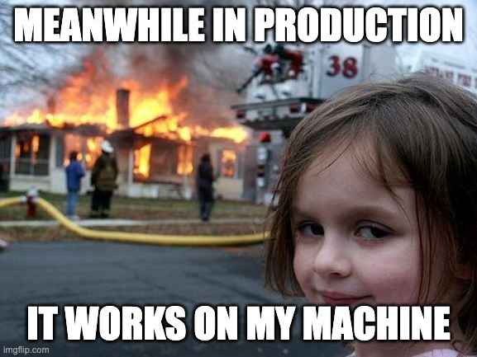
Dev ≠ Production
Development configuration is not production configuration. Your machine is not the internet.
Notes:
BEFORE YOU PRESENT: replace this placeholder with a genuine, existing meme image — do not generate one with AI, and do not invent a source URL. Search knowyourmeme.com or imgflip.com for "it works on my machine", pick an image you're comfortable using, drop it into the dashed frame, and type the real source into the attribution line. Delivery: this is a breather after a heavy technical stretch. Show it, let the room laugh for a few seconds, then land the point in one sentence and move on. Don't explain the joke. The line that connects it back: "Every one of us has said this. The attacker doesn't attack your machine. They attack the one with the public IP and the config you never re-read." Transition: "Speaking of things we never re-read — let's talk about your appsettings file."

Slide 14
THE CONFIGURATION TRAP
Configuration Is Code With Consequences
Least safe
appsettings.json
WHAT ENDS UP IN SOURCE CONTROL ANYWAY
appsettings.Development.json
Database connection strings
Third-party API keys
Environment variables
JWT signing secrets
Cloud access keys
Secrets manager / Key Vault
SMTP passwords
Managed identity
Payment provider tokens
Safest
"Git never forgets. Rotating the secret is the fix — deleting the commit is not."
Notes:
Start with the ladder on the left, bottom to top: the further down you go, the fewer humans ever see the secret. Then the honest bit: "appsettings.json is not a vault. It's a text file that gets committed, copied into a container image, and shipped to a machine you don't control. It was never designed to hold secrets and Microsoft never claimed it was." The right-hand list is what actually leaks. Every item there has caused a real breach at some company you've heard of. Practical .NET guidance to give them: user secrets for local development, environment variables or a secret store for deployed environments, Azure Key Vault or your cloud's equivalent for anything sensitive, and managed identity wherever it's available so there is no credential to steal in the first place. The best secret is the one that doesn't exist. Say the banner line twice, because people get this wrong constantly: if a secret hits a Git repository, force-pushing over the commit does not fix it. Clones exist. Forks exist. Mirrors exist. Rotate the credential. Then clean the history if you like, but rotate first. Transition: "Now — that's the code you wrote and the config you wrote. Let's talk about the hundred thousand lines you didn't."

Slide 15
A03:2025 SOFTWARE SUPPLY CHAIN FAILURES · NEW CATEGORY
You Wrote 10,000 Lines.
Your App Trusts 100,000 More.
YourApp.csproj
HOW SUPPLY CHAINS FAIL
PackageA (you chose this one)
Outdated packages nobody upgrades
Known CVEs in transitive dependencies
PackageB (A needed it)
Typosquatted or malicious packages
PackageC (B needed it)
Dependency confusion via feed order
Compromised build pipeline or signing key
LegacyUtil 1.2.0 (nobody chose this)
Floating versions that change under you
CVE — known, unpatched, reachable
Supply chain failures are new at #3 in OWASP Top 10:2025 — fewest occurrences in the data, but the highest average exploit and impact scores.
Notes:
Ask first: "Who here has actually read the licence and the source of every package in their solution?" Nobody. Good — you're normal. Walk the tree downward. You chose the top package. You did not choose the thing at the bottom. It arrived as a dependency of a dependency of a dependency, and it is running inside your process with exactly the same permissions as the code you wrote and reviewed. Big talking point: this is a brand new OWASP category for 2025 — Software Supply Chain Failures, straight in at number three. It's an expansion of what used to be called "Vulnerable and Outdated Components", widened to cover the whole ecosystem: dependencies, build systems, distribution infrastructure. What makes it nasty is the shape of the data — it has the fewest occurrences of any category, but the highest average exploit and impact scores. Rare, but when it lands, it lands hard. Practical .NET actions: turn on 'dotnet list package --vulnerable --include-transitive' in CI, enable Dependabot or Renovate, pin your versions, lock your feeds so an internal package name can't be hijacked by a public one, and use a lock file so a build in six months resolves to the same tree as today. Transition: "So: a small authorization gap. A loose config. An old package. Individually, three medium-severity tickets nobody prioritises. Now watch what happens when someone puts them together."

Slide 16
$pwd
One Bug.
Many Consequences.
Attackers don’t need your whole application to be vulnerable. They need one mistake — and a way to reach the next one.
Notes:
Reset the room. Change your tone here — this is where the talk turns from "here are some bugs" into "here is how you get breached". "Everything I showed you in the last section would be a medium-severity ticket on its own. Medium tickets don't get fixed this sprint. Now let me show you why that's the expensive assumption." Transition straight into the attack chain.

Slide 17
THE CHAIN
Severity Doesn’t Live In The First Bug
01
02
03
04
Small mistake
Information disclosure
Unauthorized access
Privilege escalation
A verbose error, a sequential ID
Internal names, versions, structure
One record that isn’t theirs
A role, a flag, an admin route
05
06
07
08
Sensitive data access
Credential discovery
Internal service access
Business impact
PII, financials, everything
Tokens and keys in the data
The systems behind the app
Money, trust, regulators
Each step is low severity on its own. The chain is what gets you on the news.
Notes:
Walk this left to right, top row then bottom row, and keep the pace up — it should feel like momentum. The line to land: "Look at step one. A verbose error message. What's the CVSS score on a verbose error message? Low. What ticket does that get? 'Nice to have, next quarter.' Now look at step eight." The point isn't that every low-severity bug becomes a breach. It's that attackers don't evaluate your bugs individually — they evaluate the path. Your scanner reports a list. An attacker builds a graph. Key lesson: you break the chain, not the list. If any single link here is missing, the attacker stops or gets loud enough to be detected. That's why defence in depth isn't a buzzword — it's arithmetic. Analogy: a burglar doesn't need the front door. They need an unlocked window, a hallway, and no alarm. Three "minor" issues. Transition: "Let me make that concrete. Fictional company, entirely realistic mistakes."

Slide 18
A STORY · FICTIONAL COMPANY, REAL MISTAKES
FinTrack: An ASP.NET Core Money App
Nothing here is a zero-day. Every single step is a ticket somebody deprioritised.
#1
#2
#3
#4
#5
Predictable IDs
No ownership check
Over-sharing API
Verbose logging
God-mode identity
Invoices numbered 1001, 1002, 1003...
[Authorize] only. No resource check.
DTO returns the full entity, incl. internal fields
Tokens and payloads written to logs
Service account can read every bucket
HOW THEY CONNECT
Guessable ID → reads another customer’s invoice → response leaks internal account references → those references appear in a log endpoint → a token in the log belongs to a service account that can read every customer file.
Notes:
Tell this as a story, not a bullet list. Slow down. Names, stakes, a villain who is bored rather than brilliant. "FinTrack is a small financial management platform. Good team. ASP.NET Core, EF Core, hosted in the cloud, CI/CD, code review on every PR. They are not careless. They have five open tickets that all say 'medium' and all got pushed to next quarter." Walk the five cards. For each one, say what the developer was thinking, because it's always reasonable: sequential IDs because that's what the database gives you. [Authorize] because it looked done. Returning the entity because writing a DTO is boring. Logging the request because production debugging is hard. A broad service account because the narrow one broke the deployment on a Friday. Then the bottom band — walk the arrow chain slowly, pausing at each arrow: "and because of that..." CRITICAL FRAMING, say it out loud: this is defensive education. I'm showing you how the pieces connect so you can look for the pattern in your own systems. I'm not giving anyone a recipe for attacking someone else's. Emotional beat to land: no single person on that team made a bad decision. The system made a bad decision, and nobody was looking at the system. Transition: "And it all starts with the least dramatic thing in software."

Slide 19
THE WHOLE TALK IN ONE SLIDE
GET /api/invoices/
1001
200 OK
GET /api/invoices/
1002
200 OK
WHAT THE DEVELOPER ASSUMED
WHAT THE ATTACKER DISCOVERED
"The UI only ever sends
IDs the user owns."
"There is no UI.
There is only HTTP."
One character changed. No exploit. No tooling. Just a question your app never learned to answer.
Notes:
This is your money slide. Barely any words — perform it. Point at the first request: "Legitimate. This is my invoice. Two hundred OK. Perfect." Point at the second, and pause before you say the number: "Now I change one digit. Two hundred OK." Then the line the whole talk hangs on — say it exactly like this: "If I change the number from 1001 to 1002 and I suddenly see someone else's invoice — did I hack your encryption? No. I didn't touch your encryption. I simply asked your application a question it never learned how to answer safely." The two boxes underneath are the real lesson. The developer's assumption isn't stupid — the UI genuinely does only send IDs the user owns. But the UI is a suggestion. curl is the truth. Your API is a public contract with the entire internet, and the browser is just one very polite client. Mention that this scales: an attacker doesn't do this twice, they do it fifty thousand times in a loop, overnight, and now it's a data breach with a number attached. Audience interaction: "Every one of you has an endpoint that takes an ID. Picture it. Now picture someone else's ID in it." Transition: "So how bad is that, really? Let's vote again."

Slide 20
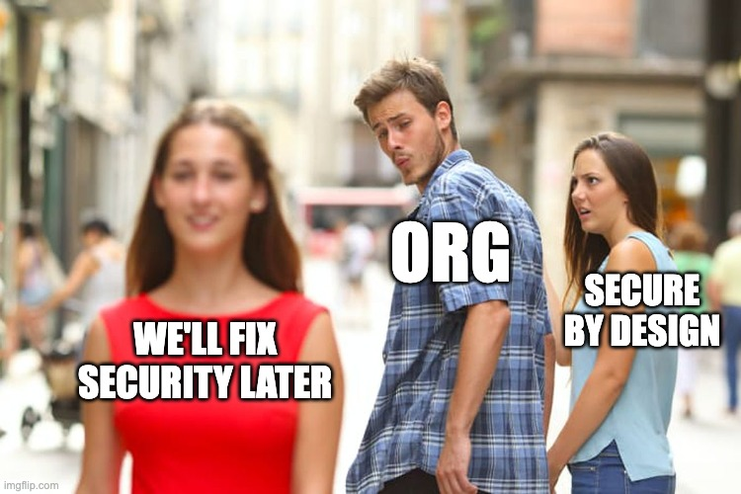
The Ticket That Never Gets Picked Up
Nobody schedules the breach. It schedules itself.
Notes:
BEFORE YOU PRESENT: swap this placeholder for a genuine existing meme image with a real source line. Do not generate one with AI and do not make up an attribution — an audience of engineers will notice, and it undercuts your credibility on a slide about honesty. Delivery: short laugh, then the sting. "Every mistake in that FinTrack story existed as a ticket. Every ticket said medium. Every medium got moved to next quarter. The attacker doesn't care about your sprint board." Optional live line if the room is warm: "Who here has a security ticket that has survived three sprints? Be honest. It's fine. It's in all our backlogs." Transition: "Which raises a fair question — how bad IS a medium, actually?"

Slide 21
QUIZ #2
How Bad Is This?
An authenticated user can retrieve another user’s invoice by changing one ID in the URL.
Low
Medium
High
Critical
A
B
C
D
THE ANSWER: it depends — and that is not a cop-out.
Data sensitivity
Number of records
Privileges reachable
Ease of automation
Business context
What it chains into
"Vulnerability severity is not the same thing as business risk."
Notes:
Run the vote for real: "A — low? B — medium? C — high? D — critical?" You will get a genuine split, and that split IS the teaching moment. Then: "You're all right. And that's the uncomfortable part." Work the factors: the same bug is Low if it exposes an invoice number on a demo tenant with four users. It's Critical if it exposes half a million financial records, or if one of those records contains a token that gets you into the next system. Identical code. Identical CVSS input. Wildly different consequences. Key lesson, and say it plainly: a scanner can tell you a vulnerability exists. Only you can tell what it's worth, because only you know what's in the data and what's next to it. That's why "we ran a scan and it was clean" is not a security programme. Careful nuance for the credibility of the room: I'm not saying CVSS is useless. I'm saying CVSS scores a vulnerability in isolation and attackers never operate in isolation. Transition: "So if severity isn't the answer, what is? Here's how attackers actually do the maths."

Slide 22
HOW IMPACT ACTUALLY ADDS UP
From Bug To Business Impact
×
×
×
×
×
Vulnerability
Exploitability
Privilege
Reach
Data sensitivity
Scale
Does the flaw exist?
How hard is it really?
What does it run as?
What can it touch next?
What is actually in there?
One record or a million?
= POTENTIAL BUSINESS IMPACT
This is a way of thinking, not a formula. There is no universal risk equation — use your threat model, your data classification, and your CVSS scores together, not one instead of the others.
Notes:
Read the six terms across, then land the multiplication: "It's multiplication, not addition. Which means any term near zero saves you — and any term that spikes ruins your week." Examples that make it click: - Privilege near zero: the bug exists but the service account can only read one table. Impact collapses. - Reach near zero: the compromised component is network-isolated with no path onward. Chain stops. - Scale enormous: one record versus every record is the difference between an apology email and a regulatory filing. READ THE ORANGE BOX OUT LOUD. This matters for your credibility with a technical audience: this is not a real risk formula, I'm not proposing a new standard, and anyone who tells you risk reduces to one number is selling something. It's a thinking tool for prioritising which of your five "medium" tickets is actually the dangerous one. Practical takeaway to give them: next time you triage a security ticket, don't ask "what's the score". Ask "what does this touch, what does it run as, and what's the next thing it reaches". Transition: "Now let's flip the table completely. Forget your bugs for a minute — how does an attacker decide you're worth their weekend?"

Slide 23
$pwd
Attackers Are Economists,
Not Magicians.
They have deadlines, budgets, and better things to do. Use that.
Notes:
Tone shift again — this section is the one people find genuinely surprising, so slow down and enjoy it. "We have a mythology problem in this industry. We picture a hoodie, three monitors, and green text. The reality is someone with a laptop, a target list, and a very ordinary question: what's the cheapest thing here that pays the most?" Transition into the mindset slide.

Slide 24
THE ATTACKER’S MATHS
Reward vs. Effort vs. Risk
Potential reward
HIGH VALUE
What do I get?
ATTACK TODAY
MAYBE. IF FUNDED.
Time
How many hours?
Effort
LOW EFFORT
HIGH EFFORT
How much skill?
AUTOMATE IT ANYWAY
IGNORE
Risk
What happens if I’m caught?
Detection
Will anyone even notice?
LOW VALUE
Your goal is not to be unhackable. Your goal is to be expensive.
Notes:
Start by dismantling the myth: "Attackers are not magicians. They're economists with a shell. They have limited hours, they get bored, and they have a return-on-investment problem exactly like your product owner does." Walk the five factors on the left, then the quadrant. The top-left box is the one that should worry you: high value, low effort. That's a public API with sequential IDs and no ownership check. That's the weekend project that becomes a breach notification. Bottom-left is subtle and worth explaining: low value but low effort still gets attacked, because it costs nothing to automate. Nobody hand-picks you — a script scans a hundred thousand hosts and you're host number 40,000. The closing line is the strategic message of the whole section: you will never be unhackable. Nothing is. What you can be is expensive enough, noisy enough, and slow enough that a rational attacker goes and finds someone easier. Security is not a wall, it's a price. Analogy that always lands: you don't need to outrun the bear. Transition: "So what makes you cheap? Here's the shopping list."

Slide 25
TARGET SELECTION
The Ten Questions Before Anyone Touches Your App
01
What is actually exposed?
06
Is there something better downstream?
02
What is valuable in there?
07
How likely am I to be detected?
03
How easy is it to attack?
08
What is the payoff worth?
04
Can I automate it?
09
How many hours will this cost me?
05
Can I escalate from it?
10
Can I chain it with something else?
ATTACK SURFACE × OPPORTUNITY × IMPACT
Notes:
Don't read all ten. Pick four and make them personal. Number one — "what is actually exposed?" — is the one most teams get wrong, because the honest answer is usually "more than the architecture diagram says". Old subdomains. A staging environment with production data. A Swagger page. An internal admin API that's internal by convention, not by network policy. Number six is the one nobody plans for: "is there something better downstream?" Your app might be boring. But your app has a database connection, a cloud identity, and API keys for three partners. You aren't the target. You're the route. Number seven — detection — is where defenders get their only real advantage, and we'll come back to it. Attackers hate noise more than they hate walls. Audience interaction: "Ask yourself question one about your own system. Not what's in the diagram — what's actually reachable from the internet right now. If you're not sure, that uncertainty is itself the finding." Transition: "Let's make the economics concrete with three targets."

Slide 26
ATTACKER ROI
Why Spend 10 Hours When 10 Minutes Might Work?
TARGET
VALUE
EFFORT
CONTROLS
ATTENTION
Target A — the bank
High
High
Mature, monitored
Later. Maybe never.
Target B — the small SaaS
Medium
Low
Basic
Worth a look
Target C — your API
High
Low
Exposed, unmonitored
RIGHT NOW
Which one gets attacked first?
Nobody is choosing you because you are important. They are choosing you because you are cheap.
Notes:
Ask the question before you reveal the last column mentally: "Three targets. You've got one weekend. Where do you go?" The room always says C, and they're right. High value, low effort, weak controls, nobody watching. That combination is the whole game. The uncomfortable reframe — deliver it gently, because this is the bit that changes behaviour: "Most of us think we're Target A. 'We're too small to be interesting.' 'Nobody's targeting us.' That's true, and it's irrelevant. Nobody is targeting you. Something is scanning everything, and you're in the everything." Note the last column of row one: mature and monitored doesn't mean unbreakable. It means expensive. That's all defence ever buys you, and it's enough. Important boundary to state plainly: this is about understanding prioritisation so you can defend better. I'm not giving anyone a methodology for picking victims, and nothing in this talk should be pointed at a system you don't own or have written permission to test. Transition: "So when they do pick you — what do they actually do? And more usefully, what should you be doing at the same moment?"

Slide 27
TWO CHECKLISTS, ONE SYSTEM
Every Attacker Step Has a Defender Answer
ATTACKER
DEFENDER
DISCOVER
"Where can I get in?"
"What is externally exposed?"
ENUMERATE
"What can I reach?"
"Are boundaries enforced per object?"
UNDERSTAND
"How does this work?"
"What do my errors and docs reveal?"
FIND WEAKNESS
"Where is the gap?"
"SAST, SCA, secret scanning, review"
VALIDATE
"Does it really work?"
"DAST and honest pentests"
CHAIN
"What does this unlock?"
"Least privilege, segmentation"
MAXIMISE IMPACT
"How far does this go?"
"Blast radius, encryption, isolation"
AVOID DETECTION
"Is anyone watching?"
"Logging AND alerting — A09:2025"
If you can’t name the control in the right-hand column, that row is currently uncontested.
Notes:
This is the hinge of the talk — the moment it stops being scary and starts being actionable. Say that out loud: "Here's the good news. This isn't magic, it's a process. And every step in a process can be interrupted." Go row by row but keep it brisk, about ten seconds each. Read the attacker question, then the defender answer. Two rows deserve extra time: CHAIN — "This is where least privilege earns its entire reputation. The attacker got in. Fine. What they get next is entirely determined by decisions you made months ago about what that service account could touch." AVOID DETECTION — "Note the OWASP category name changed for 2025. It used to be Security Logging and Monitoring Failures. Now it's Security Logging and ALERTING Failures, and that word was added deliberately. Beautiful logs that nobody reads are a very expensive way to write a post-mortem. Great logging with no alerting is close to worthless during an actual incident." Audience interaction: "Pick any row. Can you name the specific control in your system that covers it — the tool, the policy, the person? If the answer is 'I think so', that's a maybe. Attackers love a maybe." Transition: "So let's build the defender's side properly."

Slide 28
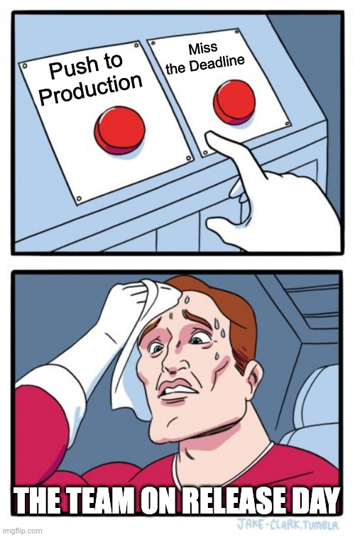
The Conversation We’ve All Had
Security Team flags a vulnerability
Temporary is the most permanent word in software.
Notes:
BEFORE YOU PRESENT: replace with a real, existing meme image and a real source line. No AI-generated memes, no invented attribution. Delivery: this is the last laugh before the constructive half of the talk. Use it as a transition rather than a gag. Line to use: "Somebody commented out an attribute to get a demo working. That was in March. It's still commented out. Nobody's fault, everybody's problem." Optional interaction: "Who has ever written the words 'TODO: add auth back'? ... Who has one of those TODOs in production right now?" Transition: "Right. Enough about how it breaks. Let's break THEIR chain instead."

Slide 29
$pwd
Now Let’s Break
The Attack Chain.
You don’t have to stop every step. You have to stop enough of them, early enough.
Notes:
Energy change: from here to the end, everything is constructive. The audience has been slightly uncomfortable for twenty minutes — give them the way out. "Everything after this slide is something you can do on Monday. Not a two-year programme. Not a new department. Things you can put in a pull request this week."

Slide 30
WHERE SECURITY ACTUALLY LIVES
Security Is a Lifecycle, Not a Release Gate
HOW WE OFTEN DO IT
BUILD
TEST
DEPLOY
SECURITY CHECK
By the time you get here, the design is set, the deadline is tomorrow, and the finding becomes a risk acceptance.
HOW IT ACTUALLY WORKS
PLAN
DESIGN
CODE
DEPENDENCIES
TEST
BUILD
DEPLOY
MONITOR
RESPOND
security decisions happen at every one of these, whether you make them or not
"Every hour you move a security decision earlier, you buy back a day later."
Notes:
Top row first, and be sympathetic: "This isn't stupidity. This is how most of us were taught to work. Build the thing, then check the thing." Then the problem with it: a finding at the gate is the most expensive kind of finding. The architecture is fixed, the release is Thursday, and there's a VP in the room. Ninety percent of the time it becomes a documented risk acceptance, which is a formal way of writing "we noticed and shipped it anyway". Bottom row: the point isn't that you need nine ceremonies. The point is that security decisions are ALREADY being made at every one of those stages. Choosing a package is a security decision. Choosing to return the whole entity is a security decision. Choosing a service account scope is a security decision. You're making them whether or not you call them that. Practical framing for their team lead: shifting left doesn't mean buying nine tools. It means the threat conversation happens at design, the dependency check happens at build, and somebody owns the alert at runtime. Transition: "Here's what that looks like with actual .NET tooling attached."

Slide 31
THE PIPELINE
A Secure .NET Delivery Pipeline
Twelve stages. Each with one concrete thing a .NET team can actually do.
01
02
03
04
Threat modelling
Secure architecture
Secure coding
SAST
One hour, a whiteboard, "what could go wrong here?"
Trust boundaries drawn before the first endpoint
Policy + resource-based authorization by default
Roslyn analyzers, CodeQL or Semgrep on every PR
05
06
07
08
SCA
Secret scanning
Security unit tests
DAST
dotnet list package --vulnerable --include-transitive
Push protection on the repo, not a post-mortem
A test that asserts user B gets 403, not 200
Automated scan against a running staging instance
09
10
11
12
Container & IaC scan
Secure CI/CD
Secure deployment
Monitor & alert
Scan the base image and the Bicep/Terraform
Signed artifacts, protected branches, scoped tokens
Managed identity, no long-lived keys, env separation
Someone gets paged for repeated 403s from one user
Pick the three you don’t have. Not all twelve. Three.
Notes:
Do not read twelve boxes. That would be a lecture. Pick four and go deep on those — the ones your audience is most likely to be missing. Recommended four to highlight: 01 THREAT MODELLING — demystify it: "It is not a document. It is one hour, four developers, a whiteboard, and the question 'what could go wrong here?' Write down the answers. That's a threat model. Anyone who tells you it needs a tool is selling a tool." 05 SCA — this one is free and most teams don't do it: 'dotnet list package --vulnerable --include-transitive'. Run it in your terminal during the coffee break. The --include-transitive flag is the important part, because that's where the scary stuff lives. 07 SECURITY UNIT TESTS — my favourite, because developers actually control it: "You already write a test that asserts user A gets their invoice. Write the other one. Assert that user B gets a 403. That single test, written once per resource type, would have prevented most of the IDOR bugs I've ever found." 12 MONITOR & ALERT — "Fifty 403s from one account in ten seconds is not a UI bug. It's someone enumerating. Does anything in your system notice that today?" End on the bottom line and mean it: nobody adopts twelve stages at once. Pick three. Transition: "And at the code level, here's the short version."

Slide 32
THE CHECKLIST
What Good Looks Like In C#
AUTHENTICATION
AUTHORIZATION
INPUT
Use ASP.NET Core Identity or an IdP
Policy-based, not scattered if-statements
Validate at the boundary, model binding aside
Short-lived tokens, real rotation
Resource-based checks on every object
Parameterised queries — no string concat
MFA on anything privileged
Least privilege, always
Allow-lists beat deny-lists
OUTPUT
DATA & SECRETS
API
Context-aware encoding in Razor / SPA
Encrypt sensitive data at rest and in transit
Rate limiting on every public/critical endpoint
DTOs, never raw entities
Key Vault or managed identity, not config
Authorize per resource, not per controller
No stack traces in production
Never log tokens, PII, or payloads
Boring, generic error responses
None of this is exotic. All of it is skippable under deadline pressure — which is exactly why it needs to be automated, not remembered.
Notes:
Tell the room upfront: "Photograph this one. It's the reference slide." Then pick one line from each card rather than reading eighteen bullets: AUTHORIZATION — "Policy-based, not scattered if-statements. If your authorization logic is spread across forty controllers as if-checks, you don't have an authorization model, you have forty opportunities to forget." INPUT — "Parameterised queries. EF Core does this for you by default with LINQ, and that's genuinely good news. But the moment somebody reaches for FromSqlRaw or ExecuteSqlRaw and builds a string, you're back in 1998. EF Core protects you right up until you ask it not to." OUTPUT — "DTOs, never raw entities. When you return the entity, you return every property somebody adds to it in six months, including the one called InternalNotes." DATA — "Never log tokens or payloads. Your logs are usually less protected than your database, get shipped to a third-party service, and are readable by more people. Attackers know this." API — "Boring error responses. 'Something went wrong' is a security control. 'Object reference not set' plus a stack trace is a free architecture diagram." The closing line is the real message: nobody forgets these because they're incompetent. They forget them at 6pm on release day. So automate the checks. Transition: "And here's where each of those hooks into the framework you already use."

Slide 33
MAPPED TO THE PIPELINE
Where The Controls Actually Sit
HTTPS / HSTS
Use HttpsRedirection, Use HSTS
Authentication
Use Authentication — identity only
Authorization
Use Authorization + policies + resource checks
Antiforgery
ValidateAntiForgeryToken on state-changing forms
Rate limiting
UseRateLimiter on public endpoints
Input validation
Model validation + explicit allow-lists
Business logic
Your rules — nothing else enforces them
EF Core
Parameterised by default; raw SQL is opt-out
Response handling
DTOs, ProblemDetails, no stack traces
Logging & telemetry
Structured logs + alerts, no secrets
The framework gives you the controls. It does not decide whether you used them.
Notes:
Frame it as "the good news and the catch". Good news: ASP.NET Core ships with genuinely strong primitives. Authentication, authorization policies, antiforgery, HSTS, built-in rate limiting, data protection, parameterised data access by default. Microsoft has done a lot of the hard work. The catch, and this is important for technical credibility — DO NOT let the room leave thinking the framework saves them: - UseAuthentication and UseAuthorization in the right order gets you a pipeline, not a policy. It answers "who are you", not "should you have this row". - EF Core parameterises LINQ queries by default. That is real protection against SQL injection. But FromSqlRaw with an interpolated string opts you straight back out, and the compiler will not stop you. - Antiforgery is on by default for Razor Pages, and is a different story for token-based APIs. - ProblemDetails gives you structured errors — but only if you configured the environment correctly, which is back to the misconfiguration slide. The banner line is the summary: the framework gives you the controls, it does not decide whether you used them. Defaults are a starting point, not a guarantee. Transition: "And all of it depends on config. Which, as we established, is where good code goes to die."

Slide 34
ACROSS ENVIRONMENTS
Four Environments, Four Different Answers
DEVELOPMENT
CI / CD
STAGING
PRODUCTION
User secrets, never appsettings
Scoped, short-lived tokens
Production-like config
Key Vault / managed identity
Self-signed certs are fine here
Secret scanning on every push
Real HTTPS + real headers
Secure + HttpOnly cookies, HSTS
Verbose errors allowed
Ephemeral build agents
No production data copies
Locked CORS, no Swagger
Synthetic data only
Signed artifacts
DAST runs here
Structured logs + real alerts
"Never trust production configuration just because development configuration works."
Notes:
The core idea in one sentence: same codebase, four completely different security postures — and only one of them is on the internet. Development: the point of user secrets is not that they're encrypted, it's that they're outside the repository folder, so you physically cannot commit them by accident. Two minutes to set up. CI/CD: this is the environment everyone forgets, and it's the one with credentials to everything. Your build agent can deploy to production. Think about what that means if someone gets a pull request to run arbitrary code in it. Staging: two rules. Make it production-like enough that testing means something. Don't put a copy of production data in it — that turns your least-protected environment into your highest-value target. I've seen far more breaches through staging than through production. Production: this column is where every earlier slide comes home. Secrets from a vault, cookies marked secure and HttpOnly, HSTS on, CORS locked to real origins, Swagger gone or authenticated, and alerting that actually pages a human. Audience interaction, and let it land uncomfortably: "How many of you could tell me, right now, without looking, whether Swagger is reachable in your production environment?" Transition: "Config is where it lives. Deployment is how it gets there."

Slide 35
THE PATH TO PRODUCTION
Controls On The Road, Not At The Gate
Developer
Git
CI
Security gates
Artifact
Container / Host
Cloud
Monitoring
Pre-commit hooks
Branch protection
SAST + SCA
Fail the build
Signed + versioned
Image scanning
IaC scanning
Central logging
Local secret scan
Required review
Secret scanning
No silent overrides
SBOM generated
Non-root, minimal base
Least-privilege identity
Alerts with an owner
THE ONE THAT MATTERS MOST
Environment separation and least-privilege identity. Get those two right and most of the chain in section two simply cannot complete — because the thing that got compromised can’t reach the thing that matters.
Automate the checks. A control that depends on someone remembering is a control that fails on a Friday.
Notes:
Move fast across the top row — the audience gets the shape immediately. The key reframe: security checks are not a gate at the end, they're a series of cheap checks along the road. A secret scan at commit time costs a developer four seconds. The same secret found after deployment costs you a credential rotation, an incident review, and a very awkward call. Call out two things specifically: SIGNED ARTIFACTS + SBOM — this is the direct answer to the new A03 supply chain category. If you can't say what's inside your build, you can't answer "are we affected?" when the next big CVE drops. And that question always arrives on a Friday afternoon. SECURITY GATES / no silent overrides — the failure mode isn't missing tools, it's tools everyone learned to skip. If your build has a warning nobody reads, you don't have a control, you have a log line. Spend real time on the purple box, because it's the highest-leverage thing on the slide: environment separation and least privilege break chains. Go back to FinTrack — if that service account could only read its own tenant's storage, the chain dies at step five. Not because the bug was fixed, but because it stopped paying. Transition: "Let's put both sides on one page."

Slide 36
MOVE FOR MOVE
Every Technique Has a Counter
ATTACKER DOES
DEFENDER DOES
Finds an exposed endpoint
Minimises and inventories attack surface
Changes an object ID
Enforces resource-level authorization
Hunts for secrets in code and logs
Uses a vault and managed identity
Chains small weaknesses together
Reduces privilege and blast radius
Automates discovery at scale
Automates security testing at scale
Counts on nobody watching
Alerts on the pattern, not just the log
"Every attacker technique should have a corresponding defensive control. If it doesn’t, that’s your backlog."
Notes:
Read these as pairs, left then right, with a small pause between each. It has a rhythm — use it. The line worth landing on row five: "They automate discovery. So automate your testing. That's not a coincidence — that's the arms race, and it's the one part of this where the defender genuinely has the advantage, because you get to run your tools against your own code with full source access, unlimited attempts, and no need to stay quiet." Row six is the one people underrate. Attackers are counting on nobody watching. Not on your firewall being weak — on your alerting being absent. Fifty 403s from one account in ten seconds should wake somebody up. In most systems it wakes up nothing at all. The banner is the takeaway of the whole section: turn the left column into your backlog. If you can't name the control on the right, that's not a gap in your knowledge, it's a gap in your system. Transition: "One last quiz. And this time, you're on the other side of the table."

Slide 37
QUIZ #3 · YOU ARE THE ATTACKER
Where Do You Start?
THE APPLICATION
FIVE THINGS YOU NOTICED
Public API
Authentication
A
Object IDs are sequential
User dashboard
Admin API
B
The admin endpoint is publicly reachable
C
Errors return full stack traces
File upload
Cloud storage
D
A NuGet package is three years old
SQL database
Payment API
E
The cloud service account can read everything
A / B / C / D / E — where do you go first, and why?
Exposure
Value
Ease
Privilege
Chain potential
Detection risk
A mature attacker doesn’t pick the worst bug. They pick the best path.
Notes:
Run this as a proper discussion, not a quick vote. Ask for a letter AND a reason — the reasoning is the whole exercise. Expected answers and how to handle them: - Most rooms shout B, the exposed admin endpoint. Good instinct: highest privilege for lowest effort. - Some say E, the broad service account. Also excellent — that's the chain multiplier, the thing that turns a small foothold into everything. - A (sequential IDs) is the quiet one. It's not the most severe on its own, but it's automatable, silent, and scales to every record you have. - C (stack traces) is nobody's first pick and is usually the actual first step, because it's free reconnaissance that tells you what everything else is built on. That's your A10:2025 category — mishandling exceptional conditions. - D (old package) depends entirely on whether the vulnerable code path is reachable. Great chance to remind them that a CVE in your dependency tree isn't automatically exploitable in your app. The reveal: there is no single right answer, and that's the lesson. A mature attacker weighs all six factors on the strip — exposure, value, ease, privilege, chain potential, detection risk — and picks the best PATH, not the worst BUG. Your scanner sorts by severity. Your attacker sorts by path. Then flip it: "Now do that exercise on your own system next week. Same six factors. That's a threat model, and it took you ninety seconds to learn." Transition: "If you forget everything else from today, keep these ten questions."

Slide 38
TAKE THIS TO WORK ON MONDAY
The 10-Second Security Test
Ask these every single time you build or review an API.
01
WHO can call it?
06
What if authentication disappears?
02
WHAT can they access?
07
What if a dependency is compromised?
03
What if they modify the input?
08
What if the server is compromised?
04
What if they call it directly?
09
What gets logged — and what shouldn’t?
05
What if they call it 10,000 times?
10
What would an attacker do next?
Ten seconds per endpoint. Cheaper than an incident review.
Notes:
Slow down. This is the practical souvenir of the talk — the thing they'll actually use. Read all ten out loud, deliberately, with a beat between each. Ten seconds of silence at the end. Let people photograph it; expect phones to come up. Frame it: "You do not need a security team to ask these. You do not need a tool. You need ten seconds and a slightly suspicious frame of mind. Ask them in code review and watch what falls out." The two most valuable, if you want to call any out: - "What if they call it directly?" — kills every assumption your UI was quietly making on your behalf. - "What would an attacker do next?" — this is the chain question, and it's the one that separates a bug list from a threat model. Personal note you can add if it's true for you: "I ask these on every review I do. Not because I'm clever, but because I've been wrong often enough to stop trusting my instincts." Transition: "And if ten is too many to remember, here are ten rules instead. Sorry."

Slide 39
IF YOU REMEMBER NOTHING ELSE
The Golden Rules
01
Never trust the client.
06
Dependencies are your attack surface.
02
Authentication is not authorization.
07
Config matters as much as code.
03
Validate at the boundary.
08
Log what matters. Alert on it.
04
Enforce least privilege.
09
Assume weaknesses will be chained.
05
Protect secrets like production data.
10
Build security into the lifecycle.
HACK TO SECURE IT · 38
Notes:
Don't labour this — the audience can read. Read the list at a steady pace and add one short line only where you have a story. Suggested emphasis, pick two or three max: - Rule 2 is the one that would prevent the most real-world breaches I've seen. It's also the one that sounds the most obvious, which is exactly why it keeps happening. - Rule 6 is the newest as far as OWASP is concerned — supply chain went straight in at number three for 2025. The code you didn't write is still your responsibility. - Rule 9 is the theme of the whole talk. Never triage a finding as if it lives alone. If you're running short on time, this is the slide to land on and skip straight to the close — everything essential is here. Transition: pause, change tone completely, then the closing statement.

Slide 40
Hackers don’t break applications.
They find the assumptions
developers forgot to secure.
Think like an attacker. Build like a defender.
You already have the hardest skill for this: you know how the thing is built.
Notes:
This is a performance moment. Do not rush and do not add anything. Deliver the first line. Pause. Deliver the second line slowly. Then pause properly — three full seconds. It will feel like ten. Hold it. Then the closing line, quieter than everything before it: "Think like an attacker. Build like a defender." Then the gift, and mean it: "Here's the thing I actually want you to leave with. Every attacker I've ever worked with, and every one I've ever worked against, would love to have what you have — the source code, the architecture, and the person who wrote it sitting two desks away. You're not behind. You start with the advantage. You just have to use it on purpose." Do not add "any questions?" here. Let it sit, then click to the Q&A slide.

Slide 41
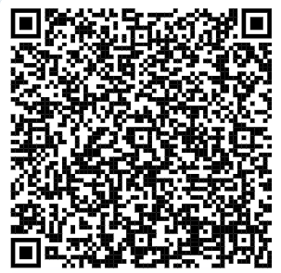
Your Turn.
What would you try to break first?
?
FIND ME
NAME
BIPUL GHIMIRE
GITHUB
github.com/hyphenTBG
LINKEDIN
linkedin.com/in/bipulghimire-thebul
EMAIL / SITE
bipulghimire.com.np
Questions
Thank you — and please go check one endpoint tonight.
Notes:
Open with the question on the slide rather than a flat "any questions?" — asking "what would you try to break first?" gets hands up far faster, and often produces the best discussion of the whole session. Before you present: replace the four placeholders, generate a real QR code pointing at your slides, and paste it over the dashed box. Questions you should expect, and short honest answers: "Is EF Core safe from SQL injection?" — By default with LINQ, yes, it parameterises. FromSqlRaw with string interpolation is opt-out and the compiler won't warn you. "Isn't [Authorize] enough?" — It answers who you are and maybe your role. It never answers whether you own this record. That's resource-based authorization, and it's on you. "Where do we start if we have nothing?" — Three things: dependency scanning in CI, secret scanning on the repo, and one authorization test per resource type. All three fit in a week. "How do we convince management?" — Don't lead with vulnerabilities, lead with the chain. Show them how three mediums become one incident. That's the FinTrack story, and it's why it's in this talk. "Should we hire a pentest?" — Eventually, and it's worth it. But fix the free stuff first, or you'll pay a specialist to find your outdated packages for you. If nobody asks anything: "Alright, then let me ask you one. Who's going to go and look at an endpoint tonight?" Hands go up, everyone laughs, you finish on a high note.

